Slide 1
US Real Estate Market
Algorithms in Economics
Aditya Sakariya (1008555225)

Slide 2
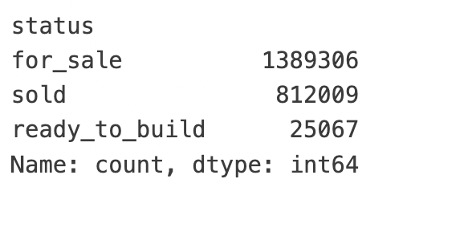
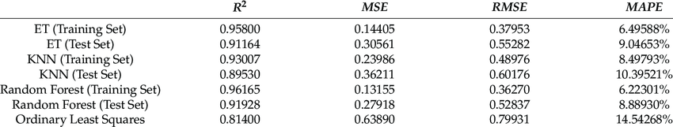
Introduction
Importance of real estate estimation in an economy:
Financial stability, Mortgage lending, Investment decisions, Taxation, Economic Indicators, Legal disputes, Urban planning
Benefits for Stakeholders
Scope of ML Applications
The Use of Machine Learning in Real Estate Research (Choy 2023)
Notes:
Financial Stability: Accurate real estate valuation helps maintain financial stability within an economy. Overvalued or undervalued property markets can lead to bubbles or crashes, respectively, affecting not only individual homeowners but also financial institutions and the broader economy. (Canada 13% the largest industry double than finance and insuarance (7%)
Mortgage Lending: Banks and financial institutions rely on property valuations to determine mortgage lending amounts. Proper valuation ensures that loans are backed by appropriate collateral values, reducing the risk of bad debts and foreclosures.
Investment Decisions: Real estate estimation provides crucial information for investors making decisions about where and when to invest. Accurate valuations help investors assess potential returns on investments and risks, influencing both residential and commercial real estate markets.
Taxation: Property taxes, a significant source of revenue for local governments, depend on real estate valuations. Accurate estimations ensure fair and equitable taxation, which funds public services and infrastructure projects that benefit the economy.
Economic Indicators: Real estate values can serve as important economic indicators. Changes in property values can reflect broader economic trends, such as inflation rates, economic growth, and consumer confidence. Policymakers and economists use these indicators to make informed decisions and adjustments to economic policies.
Insurance: Real estate estimation is crucial for the insurance industry to accurately underwrite property insurance policies. Proper valuation ensures that properties are insured at the right level, protecting owners against losses and contributing to the overall resilience of the economy.
Urban Planning and Development: Accurate property valuations are essential for urban planning and development. They help in assessing the feasibility of projects and in the allocation of resources for infrastructure development, housing, and community services, which in turn supports economic growth and sustainability.
Market Transparency and Efficiency: Real estate estimations contribute to market transparency by providing clear, accessible information on property values. This transparency supports efficient market functioning, enabling buyers and sellers to make informed decisions and facilitating smoother transactions.
Legal Disputes and Settlements: In legal disputes involving property, such as inheritance cases or divorce settlements, real estate valuation is crucial for fair resolution. Accurate valuations ensure that property assets are appropriately distributed according to their market value.
Environmental Conservation: Property valuation can also incorporate environmental considerations, assessing the value of sustainable features or the potential costs of environmental risks. This encourages the development of greener, more sustainable properties, aligning economic interests with environmental conservation efforts.
This research seeks to demonstrate how machine learning, a branch of artificial intelligence, is able to deliver more accurate pricing predictions, using the real estate market as an example. Utilizing 24,936 housing transaction records, this paper employs Extra Trees (ET), k–Nearest Neighbors (KNN), and Random Forest (RF) to predict property prices and then compares their results with those of a hedonic price model. In particular, this paper uses a feature (property age x square footage) instead of property age in order to isolate the effect of land depreciation on property prices.
Our results suggest that these three algorithms markedly outperform the traditional statistical techniques in terms of explanatory power and error minimization. Machine learning is expected to play an increasing role in shaping our future. However, it may raise questions about the privacy, fairness, and job displacement issues. It is therefore important to pay close attention to the ethical implications of machine learning and ensure that the technology is used responsibly and ethically. Researchers, legislators, and industry players must work together to create appropriate standards and legislation to govern the use of machine learning.
Evolution of Prediction Methods.
Machine Learning offers advanced methods for accurately predicting property prices and demand, surpassing traditional analytical techniques.
Highlight the shift from conventional models like linear regression to sophisticated ML algorithms that handle complex data more effectively
: Discuss how ML empowers real estate agents, investors, and buyers with more reliable data for making informed decisions
Objective of the Presentation: To explore the impact of ML on the real estate market, focusing on price prediction and demand estimation.
Briefly introduce the wide range of applications of ML in real estate, from price forecasting to identifying investment opportunities.

Slide 3
Factors Influencing Real Estate Prices

Slide 4
List of factors
Direct factors
Beds, Square feet, Size, Structure, etc
Income, relationship status, profession,
Indirect factors
Location and Accessibility: The proximity to amenities, public transport, and neighborhood quality significantly affect prices.
Market and Economic Conditions: How general economic indicators and real estate market trends influence property values.
Nontraditional Variables: The impact of proximity to luxury hotels or the density of coffee shops on property prices​.
Comparative Market Analysis: The importance of comparing similar properties in the area to estimate a property's value accurately

Slide 5
Demand estimation and price prediction of Real Estate in US

Slide 6
Data Collection
Data Gathering: The necessity of compiling comprehensive datasets, including both traditional property details and nontraditional variables​; grouped by city and state
Enhancing Model Precision: How additional data samples and feature engineering improve the accuracy of ML models​​.
Significance of Nontraditional Variables: Inclusion of unique data points like social media trends and neighborhood amenities to refine predictions​
Challenges in Data Quality: Address common issues with real estate data, such as incompleteness or errors, and data cleaning.
Web scraping realtor.com using API or HTML scraping , other cencus, and location data from google maps or national data centers
Iterative Model Improvement
Notes:
The process of continuously refining the ML model through additional data collection and feature reassessment​

Slide 7
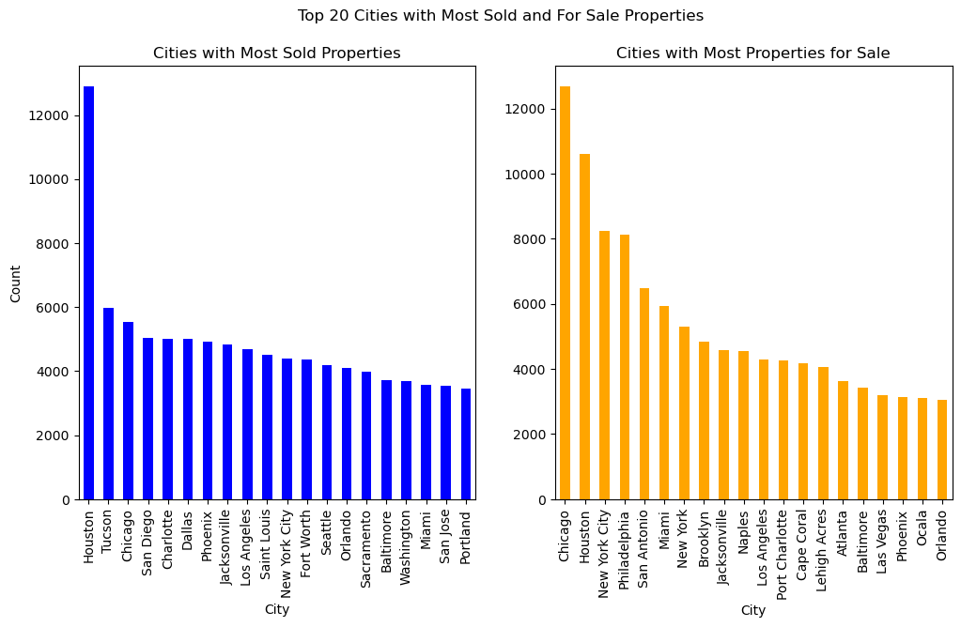
Preliminary Results: As of March 30, 2024
Huston, Chicago and New York among the top cities for sold and for sale houses.
Characterizing these cities and having an index value for these cities would help factor in unobserved variables
Notes:
The supply and demand of top 10 cities

Slide 8
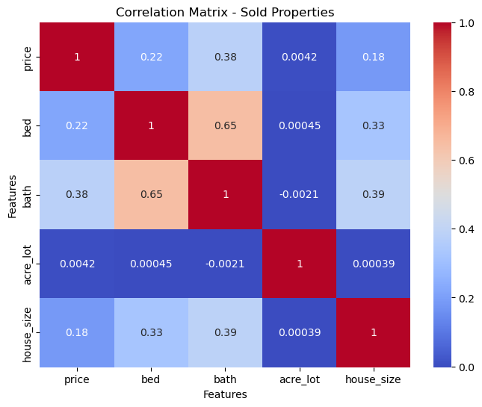
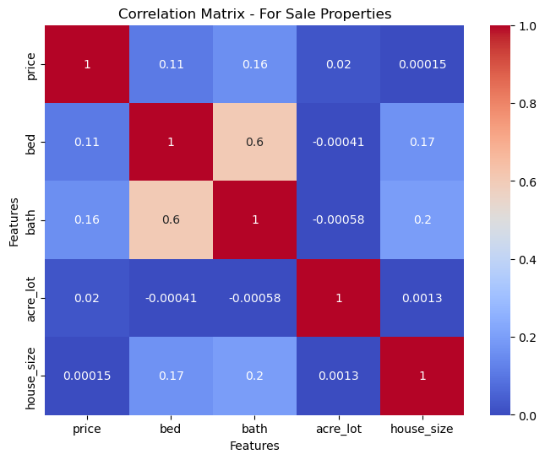
Correlation matrix for direct factors
A similar matrix would further be deduced to estimate endogeneity
It is very difficult to remove endogeneity between key variables like size, bed and bath.

Slide 9
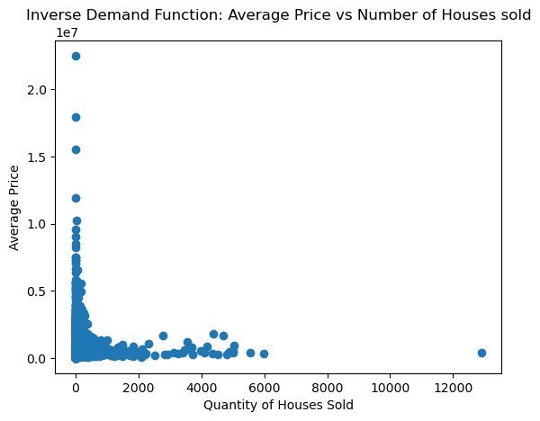
Rough inverse demand function
Grouped by city
Houses are not homogenous; they vary on so many different things.
Property valuations depend on many unobserved variables
Need of more variables and fixed effects to be controlled for

Slide 10
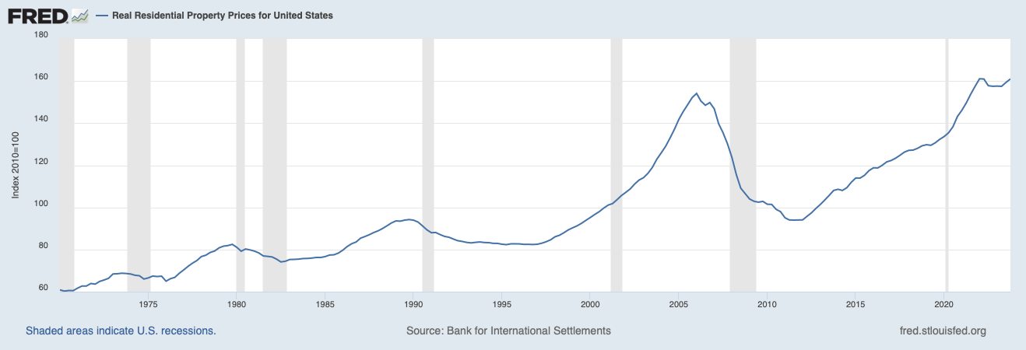
Improve demand estimation
Using marginal cost of labor and permits as an instrument variable for estimating the price of a house. (IV)
Aggregating similar houses together to homogenize them.
Explore more unobserved variables and remove endogeneity bias
Economic variables need to be specific; if recession then the cause of recession is important

Slide 11
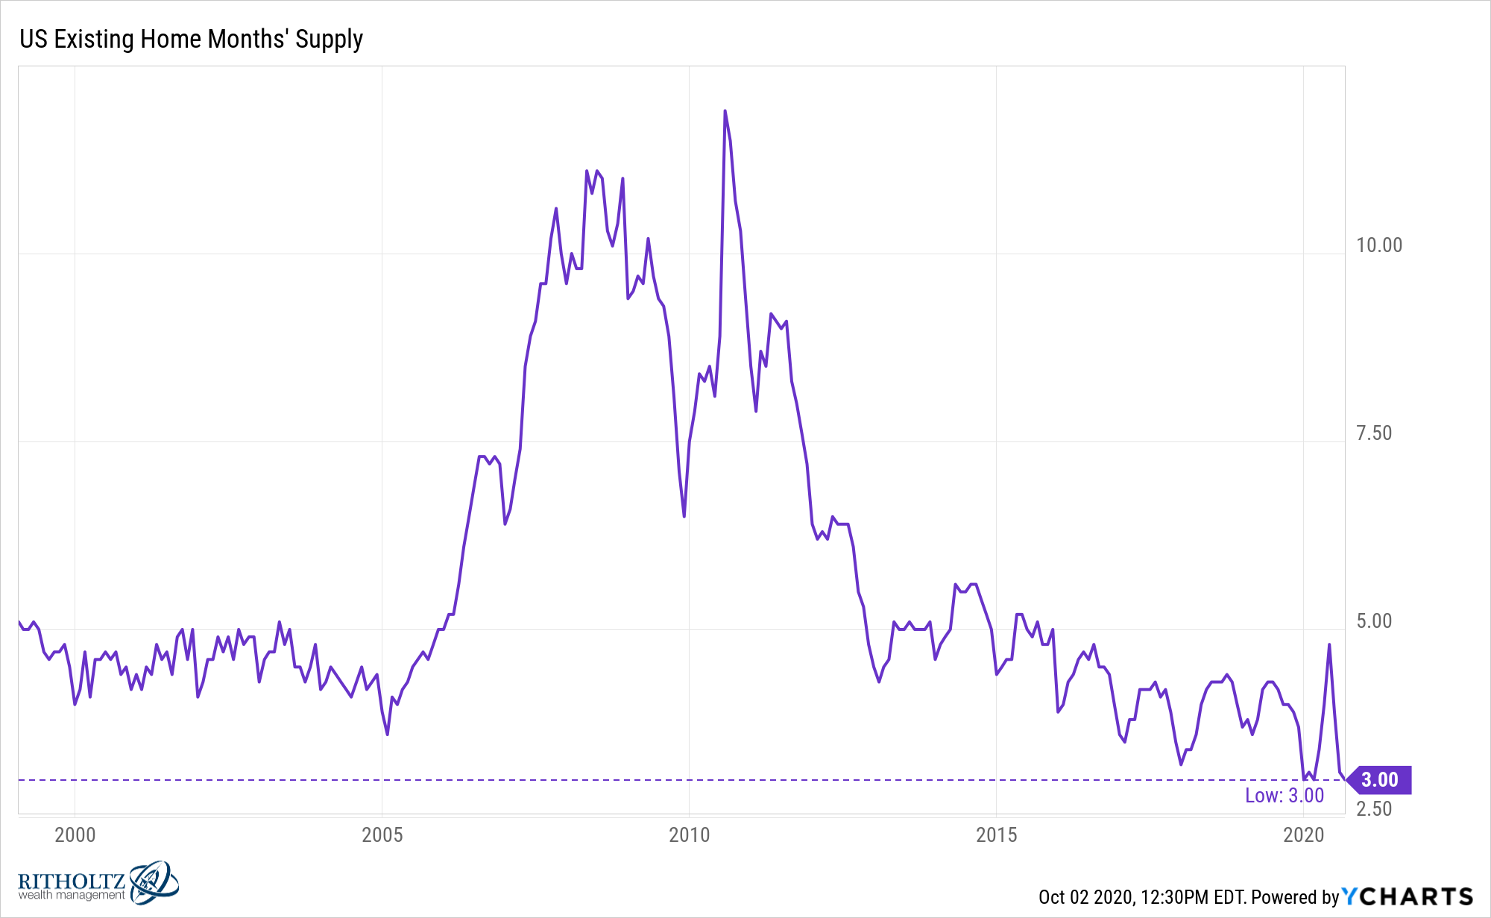
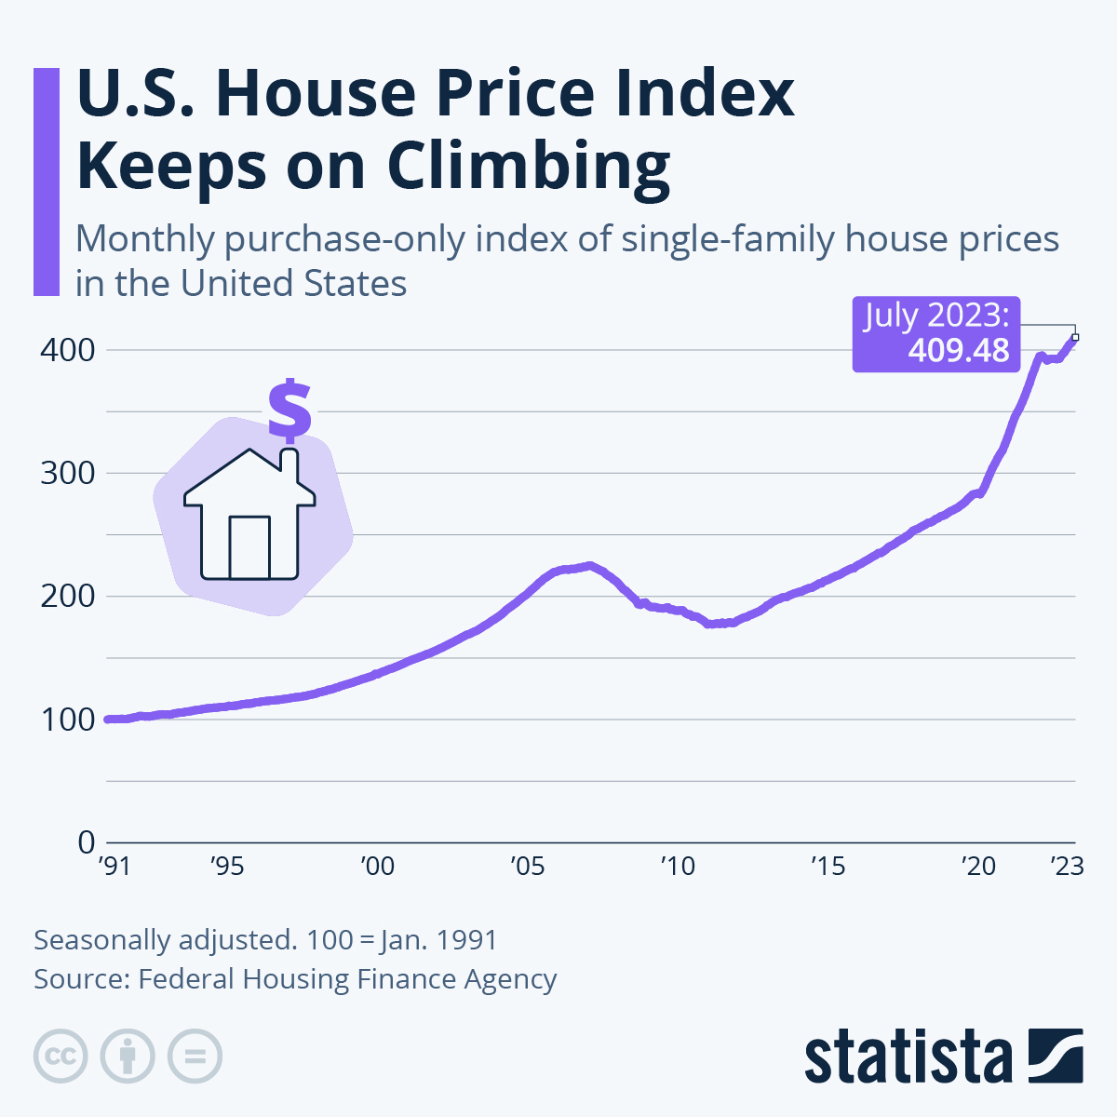
Supply vs Price
Notes:
The process of continuously refining the ML model through additional data collection and feature reassessment​

Slide 12
Market Organization

Slide 13
Auctions Algorithms
Online Optimization and Ad Auctions: reinforcement learning can discover optimal algorithms for online optimization problems, with implications for real estate auctions in adapting to market dynamics.
Autobidding Strategies: In the context of online advertising, autobidding mechanisms optimize ad campaigns under cost constraints, suggesting parallels for real estate auction strategies to maximize value.
Predicting Agent Responses: Theoretical frameworks aim to predict the actions of agents optimizing in uncertain environments, relevant for anticipating bidder behavior in real estate auctions.
Strategizing Against No-Regret Learners: Studies on interacting with no-regret learners offer insights into dynamic pricing strategies, potentially applicable to real estate bidding environments.
Notes:
Bipartite Experiment Clustering: Techniques to minimize interference bias in experiments with distinct entities suggest methods for organizing real estate market data more effectively.

Slide 14
Machine Learning Techniques in Real Estate

Slide 15
Potential models to predict
Artificial Neural Networks (ANN)
XGBoost and Regression Models: Helps in achieving high prediction accuracy​
Ensemble Methods: Combining multiple ML models can lead to more robust predictions by capturing diverse patterns in the data.
Feature Importance and Selection: Identifying key predictors among various property attributes.
Notes:
): Explain how ANNs mimic the human brain to model non-linear and complex relationships in real estate data without predefined formulas​ (ar5iv)​. Use different
XGBoost and Regression Models: XGBoost, a powerful machine learning algorithm, excels in handling regression tasks, which predict numerical values. It stands out for its speed and accuracy, using gradient boosting frameworks to optimize prediction models.
Ensemble Methods: These methods combine predictions from multiple machine learning models to improve accuracy and robustness. By aggregating diverse models, they can capture complex patterns in data that single models might miss.
Feature Importance and Selection: This process involves identifying and selecting the most relevant variables from the dataset to use in model training. Effective feature selection improves model performance by focusing on the most informative attributes.
Deep Learning Approaches: Deep learning, a subset of machine learning, uses neural networks with many layers. These models are particularly adept at identifying intricate patterns in large datasets, making them suitable for complex real estate market analyses.

Slide 16
Real-world Application

Slide 17
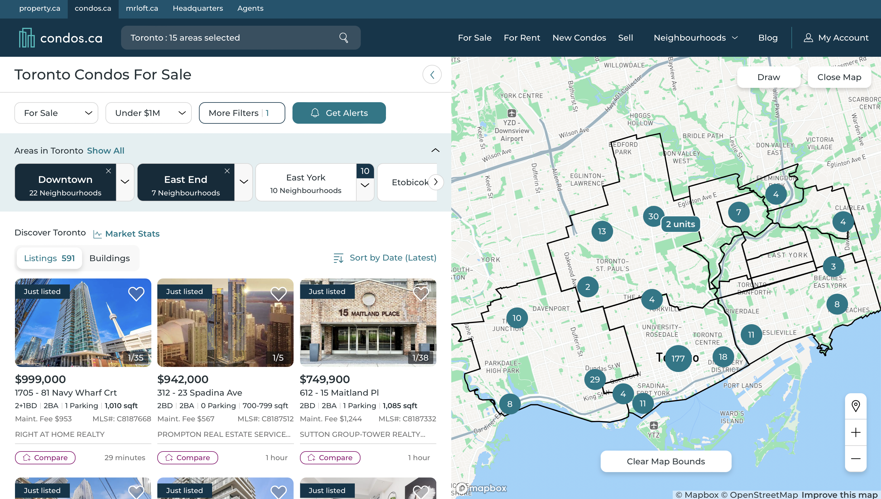
Applications
Predict macroeconomic future:
Canada housing crisis: Use data to help understand the housing market of Toronto, Vancouver and Montreal
Real Estate Bubbles: Analyze the causations for different cities since not all are the same. (Ex. Mumbai, Toronto, Miami, Tel Aviv)
Evaluate the impact of environmental policies on real estate values: Assess how green building certifications and sustainability measures affect property prices in different regions.
Analyze the effect of transportation infrastructure on neighborhood development: Use data to understand how new transit projects influence real estate values and urban growth.
Forecast the influence of remote work trends on suburban vs. urban housing demand: Predict shifts in housing market dynamics based on the increasing prevalence of remote work.
Assess the impact of demographic changes on housing needs: Analyze aging populations or migration patterns to predict future housing demand in specific areas.
Identify emerging markets for real estate investment: Use economic indicators, market trends, and social factors to pinpoint regions poised for growth or redevelopment.
Notes:
Casual inference on social trends affecting real estate prices (Selling sunsets)

Slide 18
Challenges and Solutions in ML Model Development
Data Insufficiency and Quality: Overcoming challenges related to inadequate datasets and enhancing data quality through augmentation​
Complex Model Tuning: Strategies for fine-tuning hyperparameters to optimize the performance of ML models.
Adapting to Market Changes: Ensuring models remain relevant by incorporating up-to-date data reflecting current market conditions.
Interpretability of ML Models: Addressing the need for models to not only be accurate but also interpretable to stakeholders.
Integration with Real Estate Platforms: Overcoming technical challenges in implementing ML predictions into existing real estate databases and platforms.

Slide 19
References
SciELO article on machine learning for real estate in the USA: [https://www.scielo.cl/scielo.php?pid=S0718-915X2023000100163&script=sci_arttext](https://www.scielo.cl/scielo.php?pid=S0718-915X2023000100163&script=sci_arttext)
ERA Library at the University of Alberta on machine learning in real estate: [https://era.library.ualberta.ca/items/155e8668-edcd-4d9d-ac58-e94ceed8b98a/view/498185d9-c919-49c2-99f8-b77e891d6f0d/2023_MScIT_Patel_Mirza.pdf](https://era.library.ualberta.ca/items/155e8668-edcd-4d9d-ac58-e94ceed8b98a/view/498185d9-c919-49c2-99f8-b77e891d6f0d/2023_MScIT_Patel_Mirza.pdf)
Tandfonline research on machine learning and real estate prices: [https://www.tandfonline.com/doi/full/10.1080/09599916.2020.1832558](https://www.tandfonline.com/doi/full/10.1080/09599916.2020.1832558)
MDPI article on housing characteristics and machine learning: [https://www.mdpi.com/2073-445X/12/4/740](https://www.mdpi.com/2073-445X/12/4/740)
MDPI study on ensemble methods in real estate price prediction: [https://www.mdpi.com/2073-445X/11/11/2100](https://www.mdpi.com/2073-445X/11/11/2100)
Yellow Systems case study on machine learning in real estate: [https://yellow.systems](https://yellow.systems)

